Slide 1

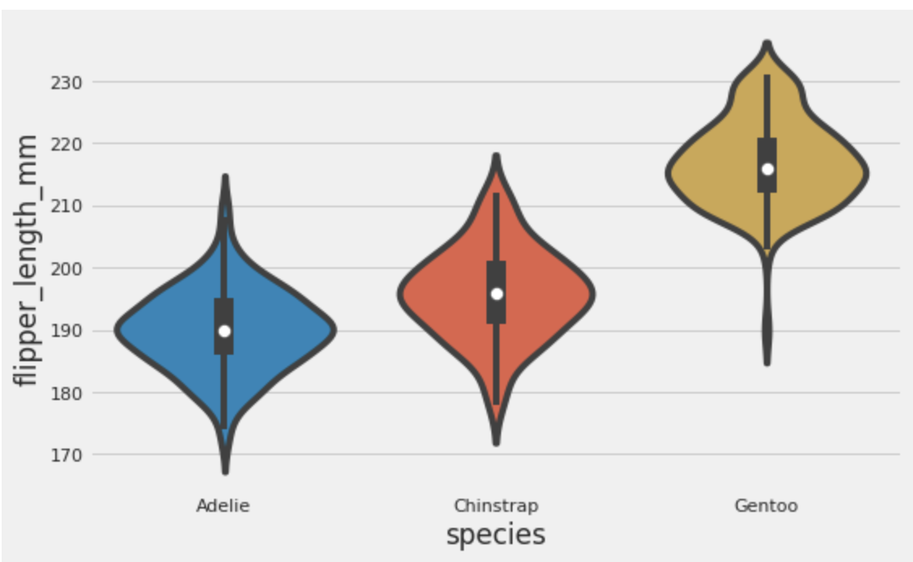
Stats lecture 5
ANOVA

Slide 2
Multiple groups
Dependent
variable
Always plot and think about your hypothesis first.
Independent variable

Slide 3
Multiple groups
Dependent
variable
I might be interested in whether different penguin species have different flipper lengths. Hence, I think species effects flipper length.
Independent variable

Slide 4
ANOVA (Analysis of variance)
An ANOVA measures the variance both within and between the groups to test whether the means are different.
The null hypothesis (H₀) of the ANOVA is no difference in means, and the alternative hypothesis (H_{a}) is that the means are different from one another.

Slide 5
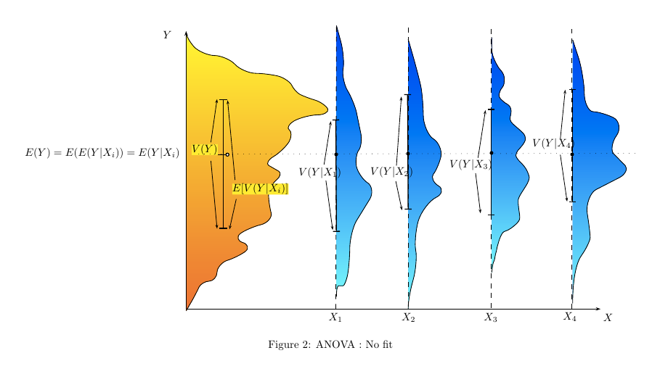
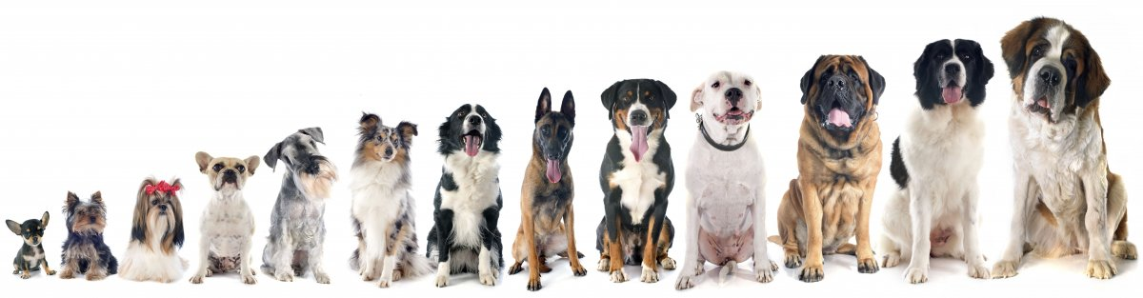
How does ANOVA work
Imagine a dog show
Lets see what groupings help predict body size
Body size of all dogs

Slide 6
How does ANOVA work
If we group them by the age of each dog in the show each group will have a similar variance to the over all distribution
Group dogs according to their age does not help explain the overall variance of body size.
That is each subgroup still looks like the overall group
Body size of all dogs

Slide 7
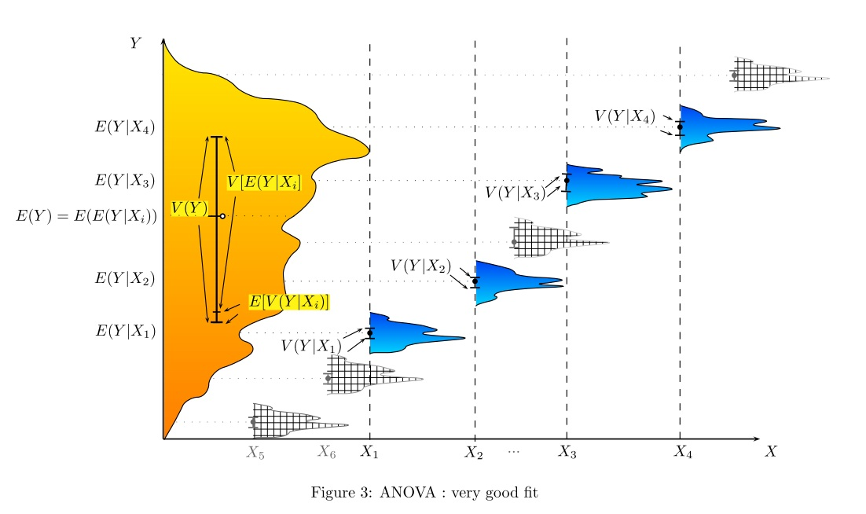
How does ANOVA work
If we group them by the breed type
Group dogs according to their breed clearly shows some groups are different.
Now the variance within each sub group is much lower compared to the overall variance (between groups)
Body size of all dogs

Slide 8
How does ANOVA work
ANOVA compares the differences in variance within and between groups
Lets consider our 4 groups of dog based on breed and ask if they differ in size

Slide 9
How does ANOVA work
ANOVA compares the differences in variance within and between groups
Lets consider our 4 groups of dog based on breed and ask if they differ in size.
We can put all the groups together and look at the overall Variance_{Total}
variance
mean
Variance_{Total} =

Slide 10
How does ANOVA work
ANOVA compares the differences in variance within and between groups
Lets consider our 4 groups of dog based on breed and ask if they differ in size.
We can calculate how far the mean of each of sub-groups is from the overall mean to get between group variance
mean_{group1}
mean_{group2}
variance
mean_{Total}
mean_{group3}
mean_{group4}
Variance_{Total} = Varaiance_{Between}

Slide 11
How does ANOVA work
ANOVA compares the differences in variance within and between groups
Lets consider our 4 groups of dog based on breed and ask if they differ in size.
We can add up the variance found within each of the sub groups to get the within group variance
variance
Variance_{Total} = Varaiance_{Between} + Varaiance_{Within}

Slide 12
How does ANOVA work
ANOVA compares the differences in variance within and between groups
Lets consider our 4 groups of dog based on breed and ask if they differ in size.
We can now test if the variance between groups is larger than the variance within groups
mean_{group1}
mean_{group2}
variance
mean_{Total}
mean_{group3}
mean_{group4}
Variance_{Total} = Varaiance_{Between} + Varaiance_{Within}

Slide 13
How does ANOVA work
If variance between groups is much larger than the variance within groups
it suggests a difference between groups.
mean_{group1}
mean_{group2}
variance
mean_{Total}
mean_{group3}
mean_{group4}
Variance_{Total} = Varaiance_{Between} + Varaiance_{Within}

Slide 14
How does ANOVA work
If variance within groups is larger
than the variance between groups
it suggests that there is no difference between groups.
mean_{group1}
mean_{group2}
variance
mean_{Total}
mean_{group3}
mean_{group4}
Variance_{Total} = Varaiance_{Between} + Varaiance_{Within}

Slide 15
How does ANOVA work
To test if these differences are significantly different we need to compare them to a NULL
H₀: Each of the sub-groups are samples drawn from the same normal distribution.
H_{A}: The sub-groups are samples drawn from from set of normal distribution with differing means (but equal variances).
H₀ The sub-groups are only different by chance
H_{A} The sub-groups are not all from 1 distribution

Slide 16
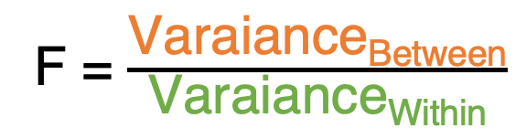
How does ANOVA work
Calculate an F value
F = $\frac{\text{Varaiance}\text{Between}}{\text{Varaiance}\text{Within}}$
mean_{group1}
mean_{group2}
variance
And than compare this F-value to a value (critical score) expected under the NULL hypothesis
If F > critical score we reject the NULL
If F < critical score we accept the NULL
The p-value we will the probability of getting a value of F > critical score
mean_{Total}
mean_{group3}
mean_{group4}

Slide 17
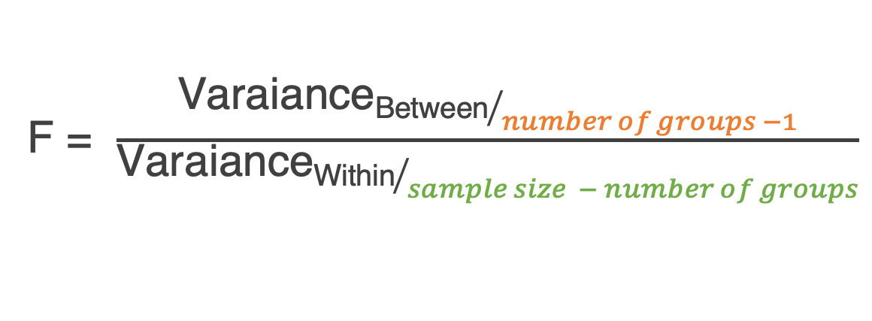
How does ANOVA work
What about the sample size
Larger samples sizes make it easier to determine if the groups are from the same shared distribution. We incorporate this using the degrees of freedom
Degree of freedom for variance between groups.
Having more groups splits the data and makes it harder to find a difference
F = $\frac{{\text{Varaiance}\text{Between}}/{number of groups −1}}{{\text{Varaiance}\text{Within}}/{sample size − number of groups}}$
Degree of freedom for variance within groups.

Slide 18
ANOVA in R
In R we will write models using the math's notations
Response variable ~ Explanatory variable
As the response variable is on the y-axis
and the explanatory is on the x-axis we often write it as
Y ~ X
In R if we want to run an ANOVA using the aov() function we write
aov(Y ~ X)

Slide 19
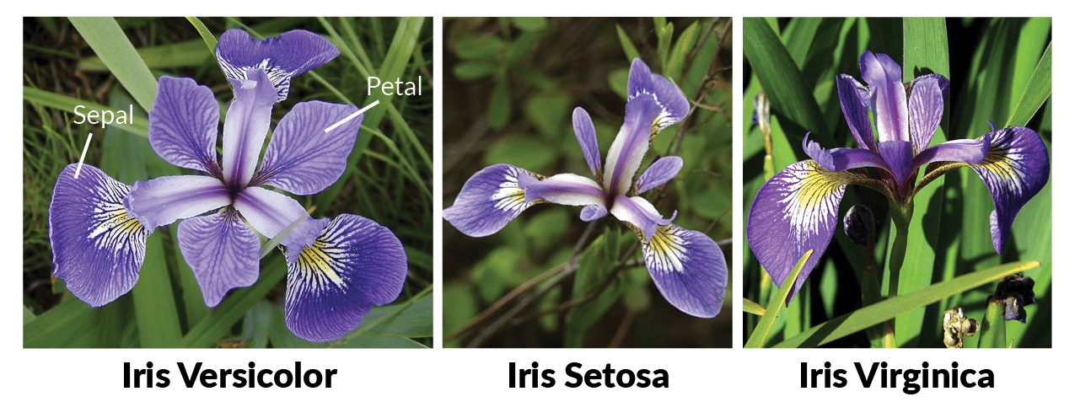
ANOVA in R
Lets test if the petal width is different across iris species

Slide 20
ANOVA in R
Lets test if the petal width (iris$Petal.Width)
is different across iris species (iris$Species)
mod1 <- aov(Y ~ X)
summary(mod1)

Slide 21
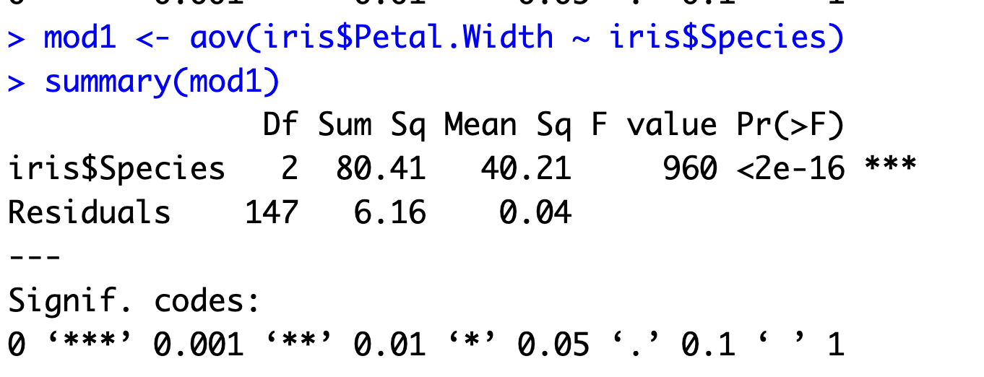
ANOVA in R
Lets test if the petal width (iris$Petal.Width)
is different across iris species (iris$Species)
mod1 <- aov(Y ~ X)
summary(mod1)

Slide 22
ANOVA in R
This is the between group variation

Slide 23
ANOVA in R
This is the within group variation

Slide 24
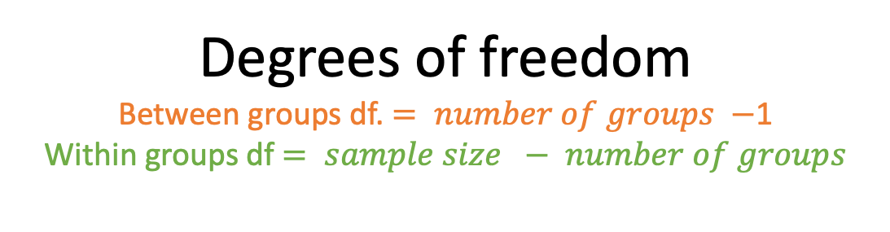
ANOVA in R
Degrees of freedom
Between groups df. $= number of groups −$1
Within groups df $= sample size − number of groups$

Slide 25
ANOVA in R
Sum of the squares
Variance measure similar to how we measured variance in week 3

Slide 26
ANOVA in R
Mean Sum of the squares
Sum of squared divided by degrees of freedom

Slide 27
ANOVA in R
F value
Between group Mean sum of Sq
divided by
Within Mean sum of Sq

Slide 28

ANOVA in R
F = $\frac{{\text{Varaiance}\text{Between}}/{number of groups −1}}{{\text{Varaiance}\text{Within}}/{sample size − number of groups}}$

Slide 29
ANOVA in R
P-value is calculated by comparing the F-value to a table of expected values. Its the probability of saying F is larger than 1 when its really only larger than 1 by chance (i.e. type II error).

Slide 30
ANOVA in R
ANOVA does not tell you which group is different to the others

Slide 31
ANOVA Assumptions
When we fit something like a mean
Every data point will have a residual
to that fitted value
ANOVA assumes that the data and more importantly the residuals are normally distributed.
Residuals are the distances of each data point from some fitted value.
Residual for datapoint 2 = 1
variance
mean_{Total}
Residual for datapoint 1 = - 5

Slide 32
ANOVA Assumptions
When we fit something like a mean
Every data point will have a residual
to that fitted value
ANOVA assumes that the data and more importantly the residuals are normally distributed.
Residuals are the distances of each data point from some fitted value.
mean_{group1}
variance
mean_{Total}
mean_{group2}

Slide 33
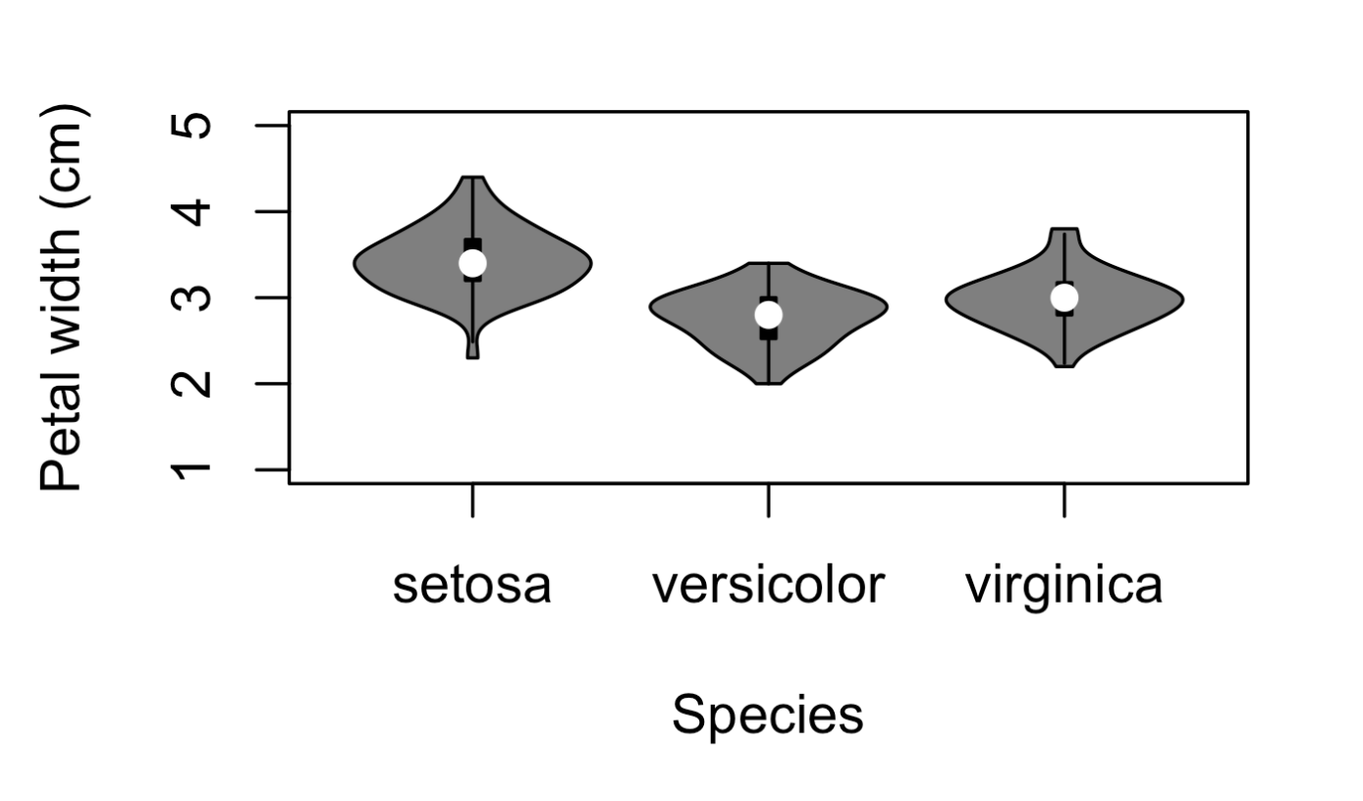
ANOVA Assumptions
We can check our data by just plotting them
Its subjective but a great way at spotting funky looking distributions.
These all look relatively normally distributed so ok.
ANOVA assumes that the data and more importantly the residuals are normally distributed.
Residuals are the distances of each data point from some fitted value.

Slide 34
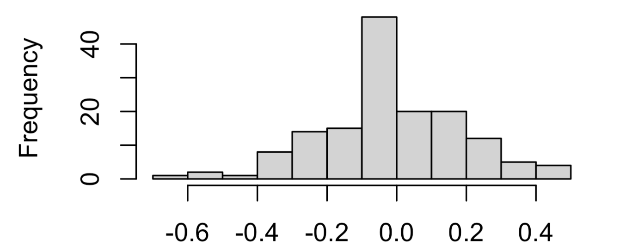
ANOVA Assumptions
We can also directly plot the residuals of our model to see if they look normal
hist(mod1$residuals)
ANOVA assumes that the data and more importantly the residuals are normally distributed.
Residuals are the distances of each data point from some fitted value.
Why is it important that the residuals are normally distributed?
Remember variance is measured using a mean and non normal distributions might not have clear central tendencies

Slide 35
ANOVA Assumptions
QQ plots
Compares the distribution of our residuals to an idealized normal distribution.
Its starts at one end of the distributions (1st quantiles) and cumulatively adds up the values
First lets take our distribution of residuals

Slide 36
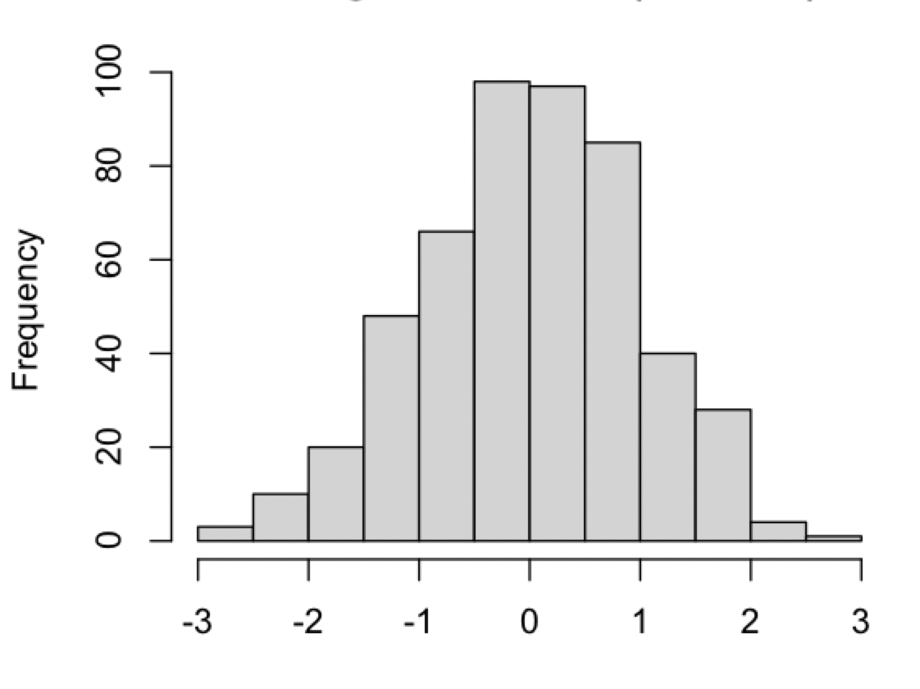
ANOVA Assumptions
QQ plots
Compares the distribution of our residuals to an idealized normal distribution.
Its starts at one end of the distributions (1st quantiles) and cumulatively adds up the values
Next we can create a theoretical distribution of residuals
for our model that follows a normal distribution.
We will compare our observed residuals to this distribution
to decide if our distribution is normal.

Slide 37
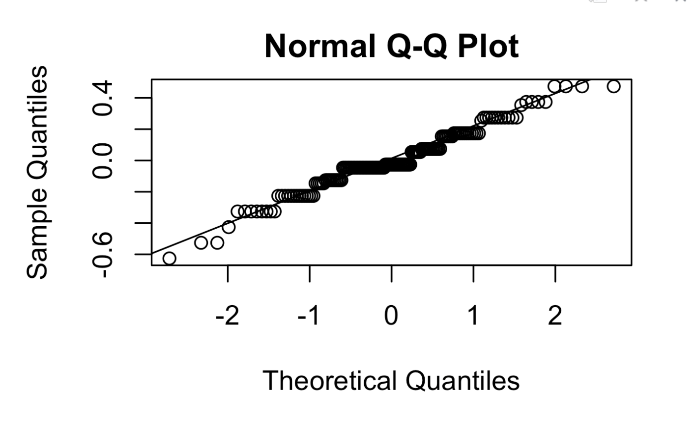
ANOVA Assumptions
QQ plots
Compares the distribution of our residuals to an idealized normal distribution.
Its starts at one end of the distributions (1st quantiles) and cumulatively adds up the values
We do this by looking at each section of the our
distribution, the quantiles, and asking if they add up to
a similar value to the theoretical one.

Slide 38
ANOVA Assumptions
QQ plots
Compares the distribution of our residuals to an idealized normal distribution.
Its starts at one end of the distributions (1st quantiles) and cumulatively adds up the values
We do this by looking at each section of the our
distribution, the quantiles, and asking if they add up to
a similar value to the theoretical one.

Slide 39
ANOVA Assumptions
QQ plots
Compares the distribution of our residuals to an idealized normal distribution.
Its starts at one end of the distributions (1st quantiles) and cumulatively adds up the values
We do this by looking at each section of the our
distribution, the quantiles, and asking if they add up to
a similar value to the theoretical one.

Slide 40
ANOVA Assumptions
QQ plots
Compares the distribution of our residuals to an idealized normal distribution.
Its starts at one end of the distributions (1st quantiles) and cumulatively adds up the values
If the residuals are close to the line it indicates that they
are distributed normally.
Subject to how close but give a good visual indication.

Slide 41

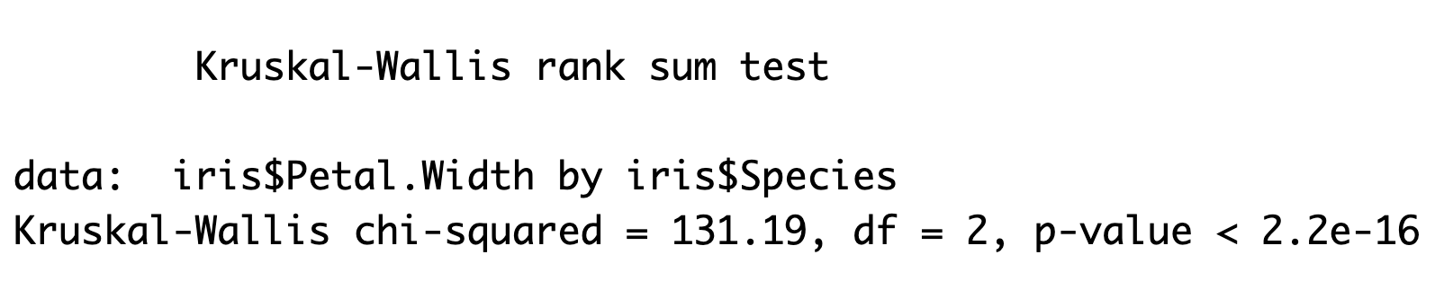
Kruskal-Wallis
Non-parametric version of an ANOVA
Batch A
Rank 8
Rank 6
Rank 9
The Kruskal-Wallis test works in the same way as the Mann Whitney U test where instead of using values of means and variance it uses the rank sum of the groups.
It tests whether the rank sum is different between the groups.
This means it does not assume a normal distribution, only that the values are ordinal.
We can do this easily in R using the flowing code
kw_mod <- kruskal.test(iris$Petal.Width ~ iris$Species)
kw_mod
5.3
5.0
5.9
Rank 11
Rank 12
Rank 10
6.5
6.9
5.9
Batch B
Rank 5
Rank 7
Rank 3
4.5
5.1
3.9
Rank 4
Rank 2
Rank 1
4.0
3.5
3.0

Slide 42
Post hoc tests
ANOVA does not tell you which group is different to the others
Why not run a series of t-test for each pairwise comparison?
?
?
?

Slide 43
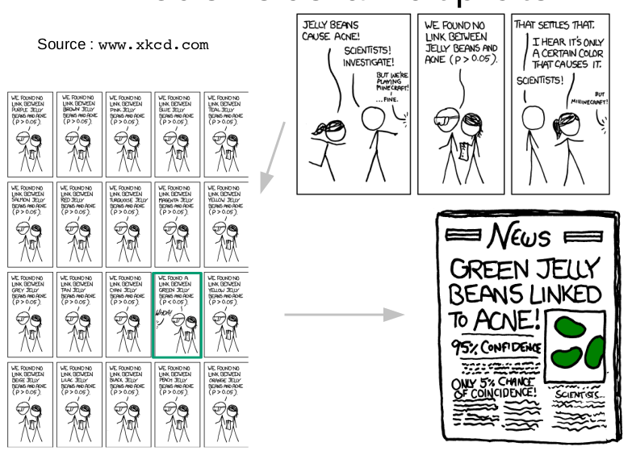
If we run a test enough times we will eventually reject the null just by chance

Slide 44
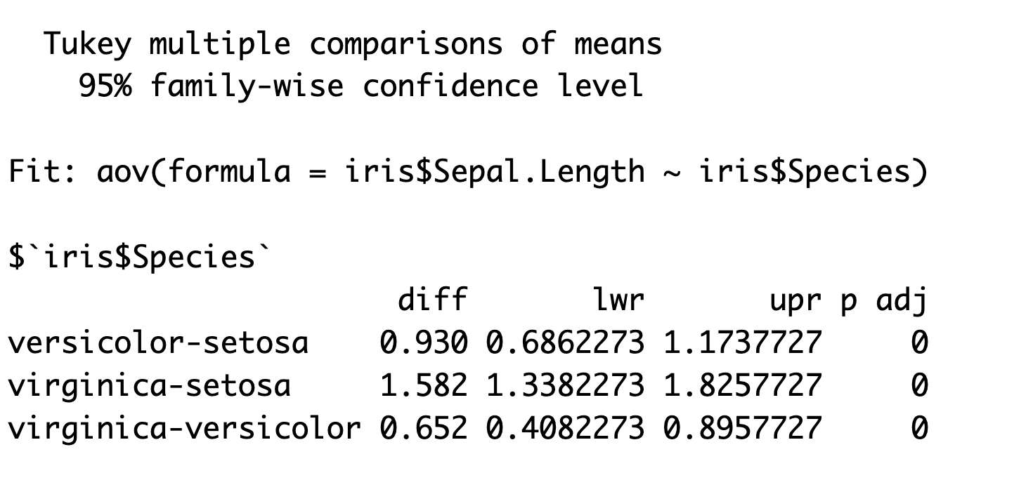
Tukey post hoc test
Tukeys post hoc test conducts a pairwise comparison between each group using a test similar to a t-test but which compares all groups at the same time and adjusts the p-value to avoid inflating type I errors
tukey_res <- TukeyHSD(mod1)
tukey_res
Each pairwise
comparison

Slide 45
Tukey post hoc test
Tukeys post hoc test conducts a pairwise comparison between each group using a test similar to a t-test but which compares all groups at the same time and adjusts the p-value to avoid inflating type I errors
tukey_res <- TukeyHSD(mod1)
tukey_res
Difference between group means

Slide 46
Tukey post hoc test
Tukeys post hoc test conducts a pairwise comparison between each group using a test similar to a t-test but which compares all groups at the same time and adjusts the p-value to avoid inflating type I errors
tukey_res <- TukeyHSD(mod1)
tukey_res
Critical values used to calculate p-value

Slide 47
Tukey post hoc test
Tukeys post hoc test conducts a pairwise comparison between each group using a test similar to a t-test but which compares all groups at the same time and adjusts the p-value to avoid inflating type I errors
tukey_res <- TukeyHSD(mod1)
tukey_res
Adjusted p-values

Slide 48
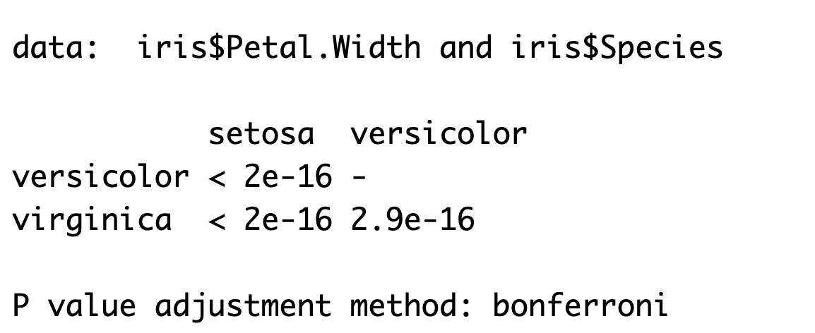
If using a non parametric test
Tukeys post hoc test requires normal residuals.
If we used the non parametric Kruskal-Wallis test we
Could Test pairwise differences using a series of Mann–
Whitney U tests with the p-values adjusted to account for the inflated
probability of a type I error (called Bonferroni tests).
pairwise.wilcox.test(iris$Petal.Width, iris$Species,
p.adjust.method = "bonferroni")
Each pairwise comparison
is given in a matrix with
The associated p-value

Slide 49
Summary
For multiple groups we use ANOVA
ANOVA works by comparing between group variance to within group variance
Residuals need to be normally distributed and QQ plots can check this
Kruskal-Wallis is the non-parametric version of ANOVA and should be used when residuals are not normally distributed.
Post hoc tests are required to test which groups differ to avoid inflating type I errors
Tukeys test should be used for ANOVAS, Bonferroni corrected Mann–Whitney U tests should be used for Kruskal-Wallis tests

